Slide 1

“Performance evaluation of Dynamic RAN slicing in 5G Network”
Team No: N20
Name | USN
Pragathi Pujari | 01FE20BCS189
B Ajay Kushal | 01FE20BCS289
Lavanya Shahapur | 01FE20BCS185
Kushagra Tomar | 01FE20BCS063
Ashwini Jannu | 01FE20BCS208
Guided by
Mr.Parikshit P Hegde

Slide 2

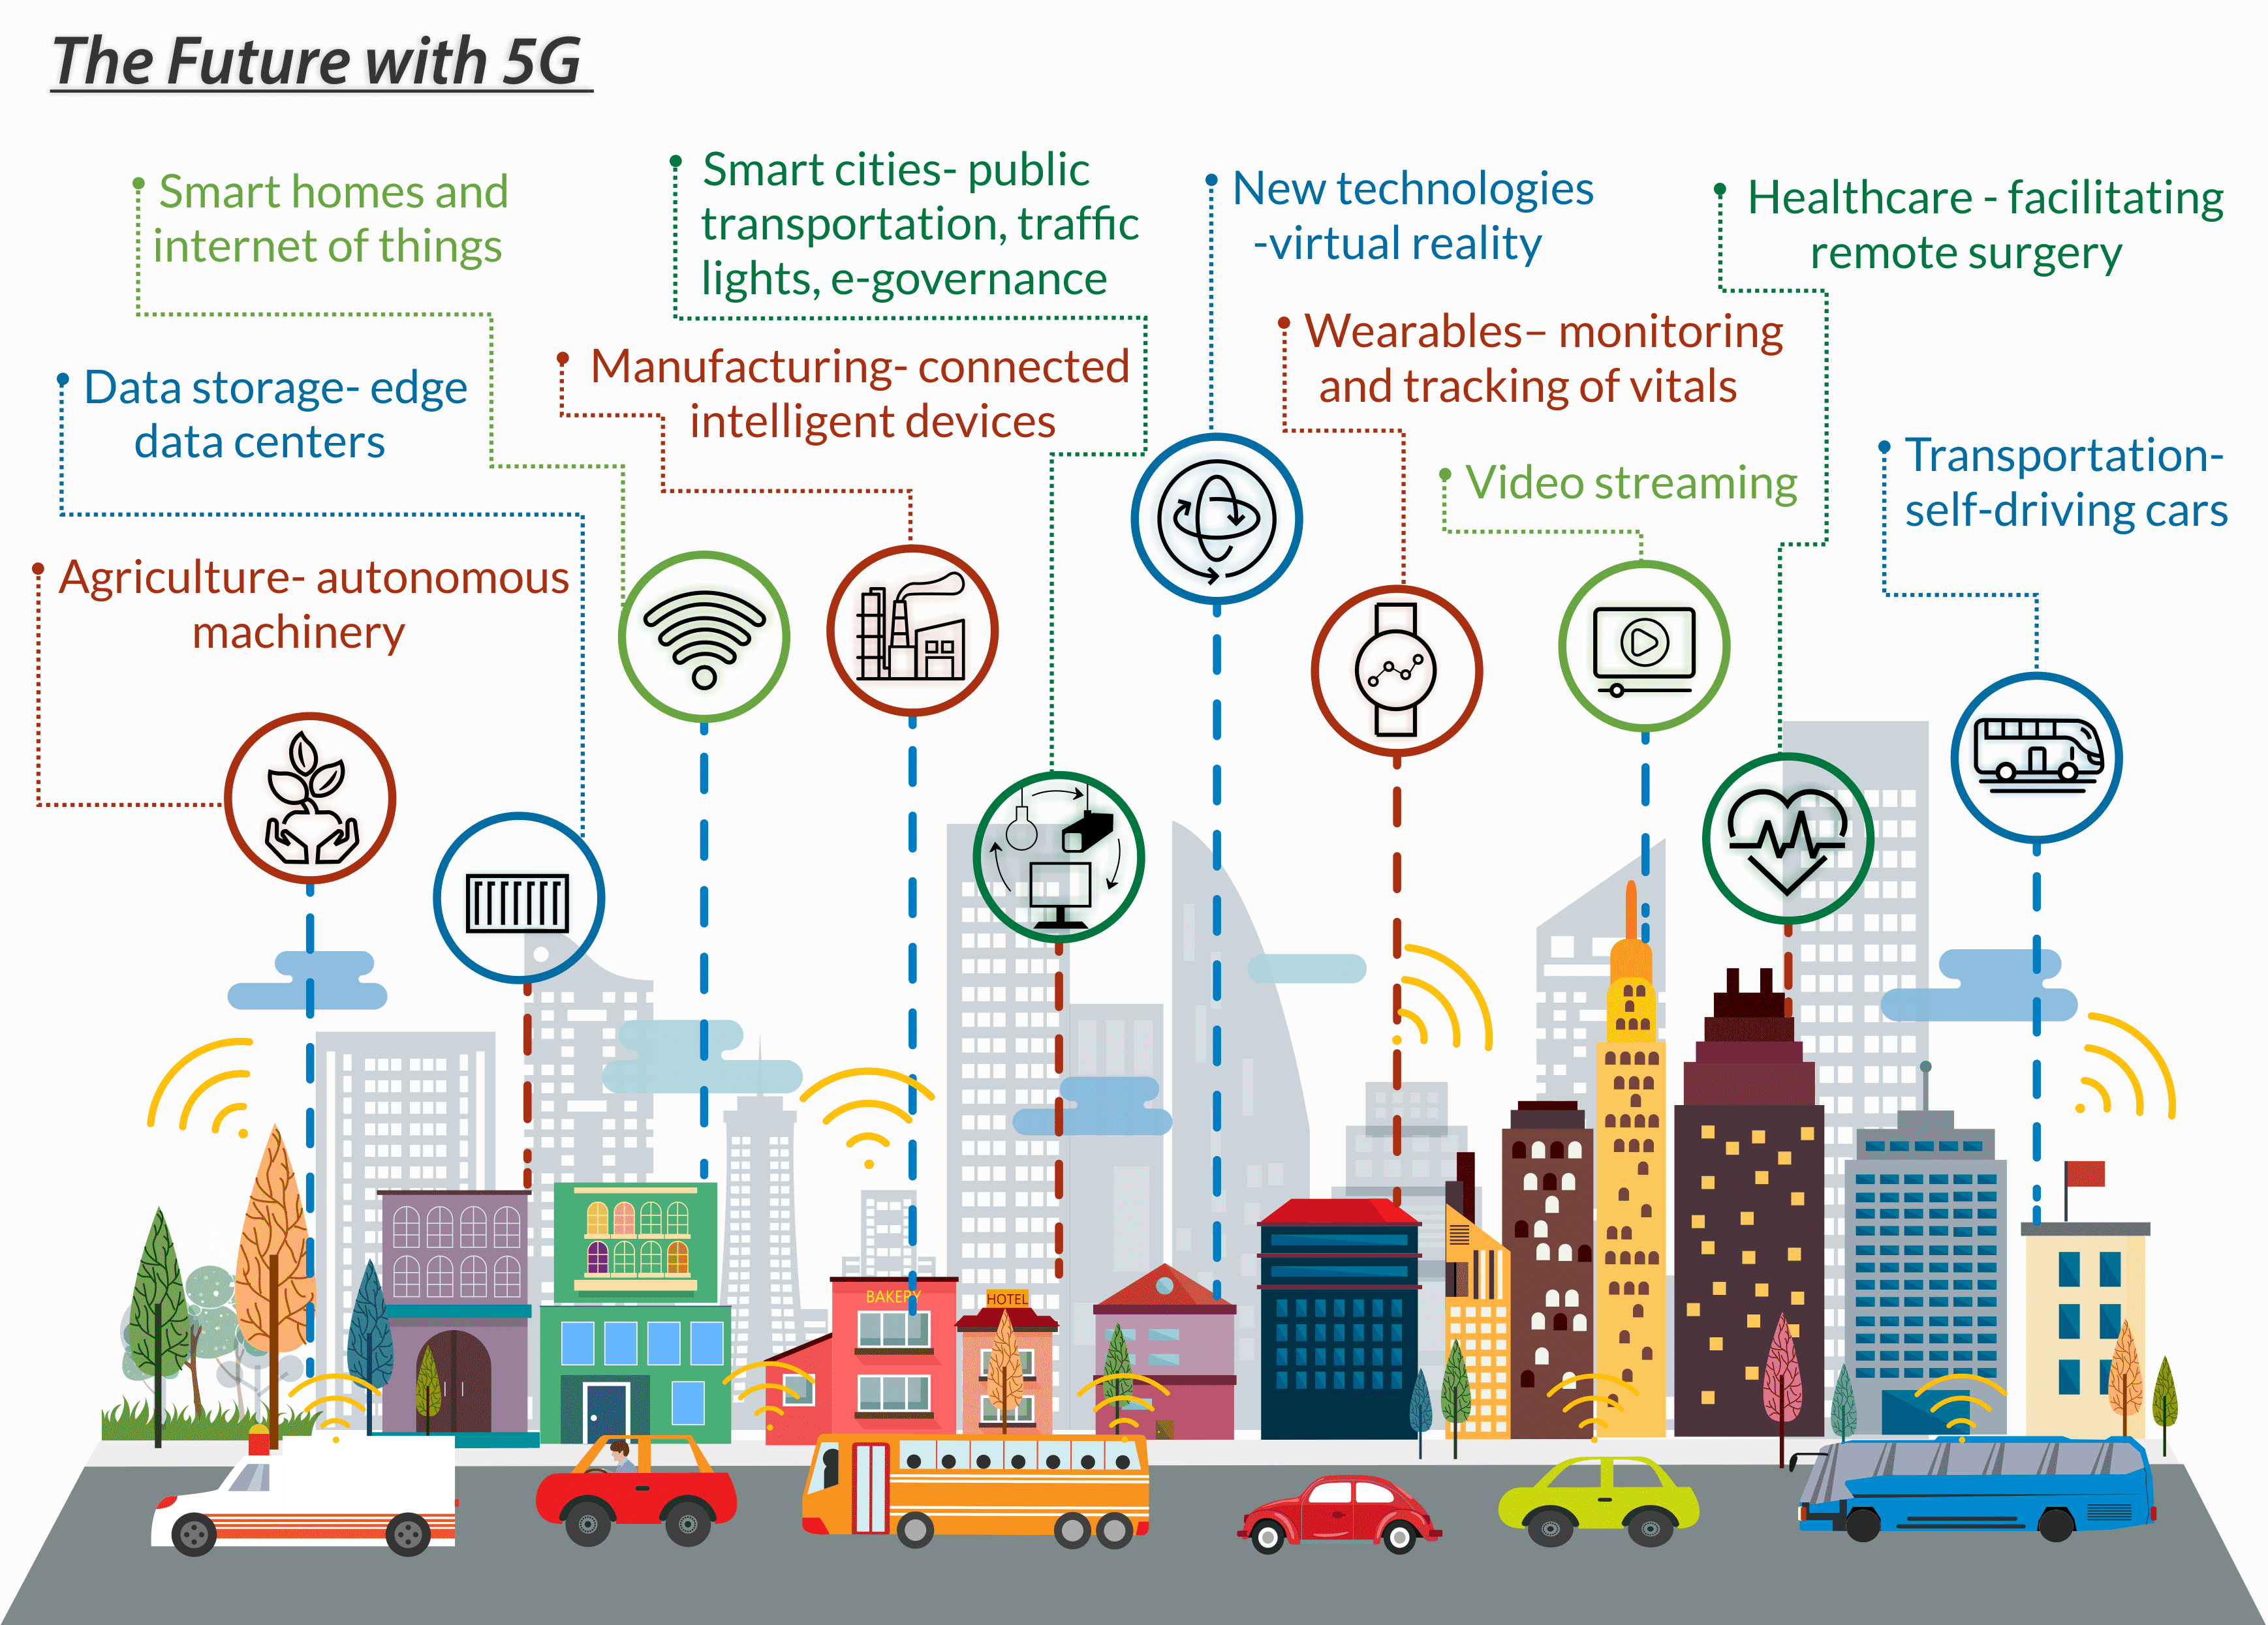
Introduction: 5G Network
Fifth-generation wireless networks are to bring a major transformation to the current fourth-generation network by supporting billions of devices that will be connected to the Internet and by providing higher data speeds, ultra low latency, more reliability, and massive network capacity.

Slide 3
Introduction: 5G Network Slicing
The 3GPP has recognized network slicing to be an essential overall component of 5G. This has made slicing an ongoing focus for working groups developing 5G core architecture.
A 5G network slicing can be performed across Radio Access Network (RAN), Core Network (CN), and Cloud network.
5G provides network slicing as a fundamental capability, whereas 4G and earlier generations of cellular data services could not support network slicing.
Slicing this network enables the network operator to maximize the usage of network resources and allow service flexibility.

Slide 4

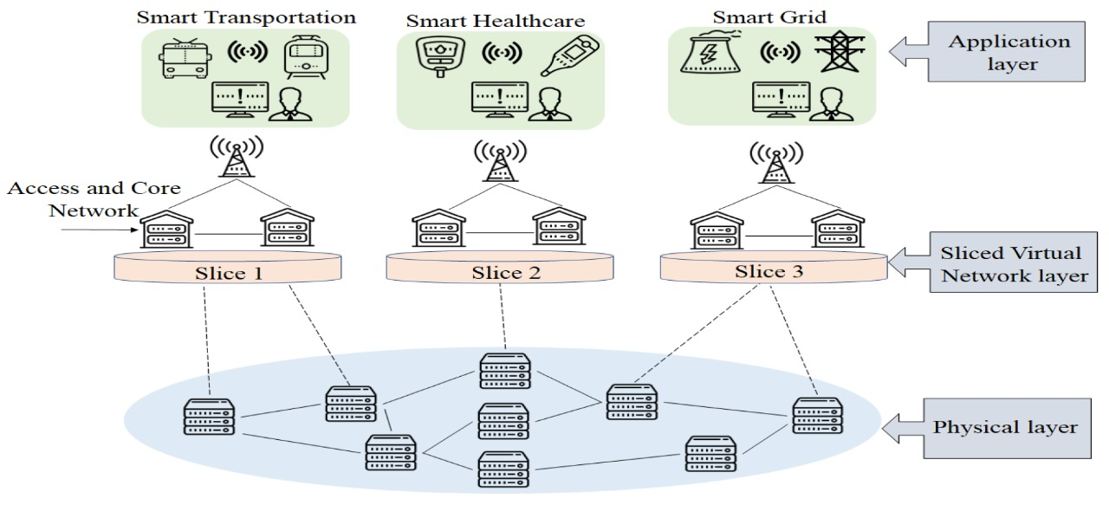
Motivation : 5G RAN Slicing
It is the key factor to optimise 5G network so that they efficiently address all the three use cases.
This area needs more attention and still more research is needed.
Static slicing lacks in dynamically allocating resource.
Dynamically create new slice, deploying service on pre-existing slice, and customize slices.

Slide 5
Problem Statement
“Performance evaluation of varied Key Performance Indicators (KPIs) for dynamic Radio Access Network(RAN) slice environment of 5G Networks”

Slide 6
Objectives / Goals
To simulate dynamic slicing of 5G RAN.
Supports multiple logical networks over common infrastructure.
To simulate resource allocation with tailored solutions to separate slices.
To evaluate KPI’s with respect to the different video streaming use cases.

Slide 7
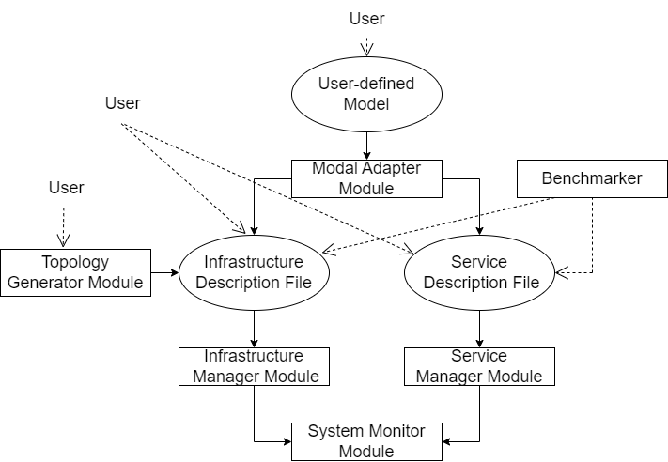
Proposed System
Single arrow represent mandatory flow
Dashed line represent user inputs
Dotted line represent optional flow
Rectangle represent system modules
Circles represent input JSON files
Fig.1. eXP-RAN workflow and system modules

Slide 8
Description of Target users
Service providers – Creates new slices to deploy service and allocate tailored resources to slices.
Network users – Use 5G enabled services.
Network operators – Deploy service on existing slice and allocate tailored resources to slices

Slide 9
Scope
The main intension behind working on this problem definition was to evaluate the performance of RAN Slicing in 5G Networks.
QoS (Quality of Service) evaluation in video streaming
MEC /vRAN emulation
Network Traffic Analysis
Packet loss tracing during emulation.

Slide 10

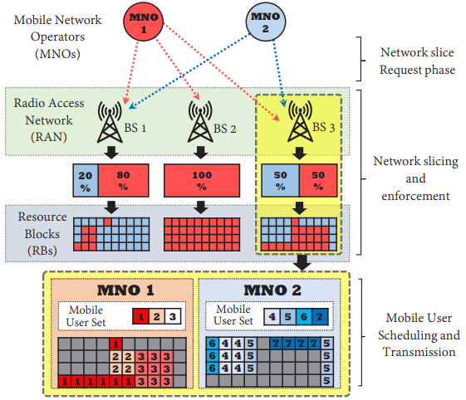
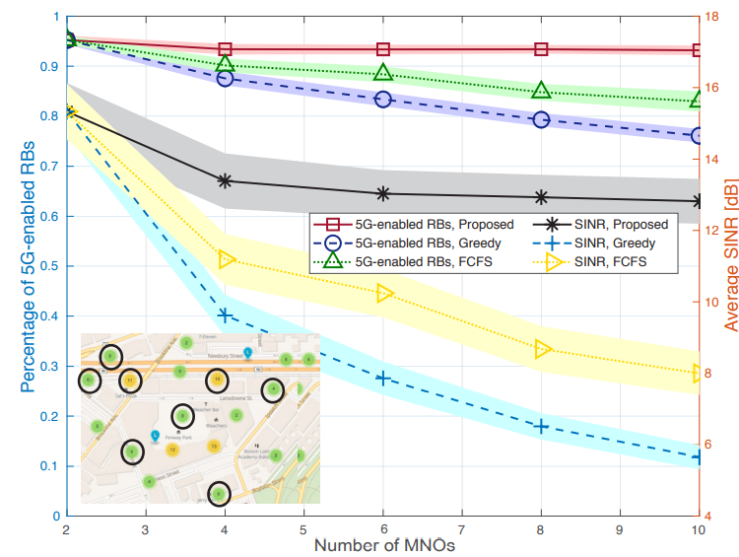
Toward Operator-to-Waveform 5G Radio Access Network Slicing
Link to the Paper
Methodology
Introduction
Radio access network (RAN) slicing is expected to be a pivotal component of next-generation 5G networks [1] and the Internet of Things [2, 3]. By leveraging virtualization of physical network resources, infrastructure providers (IPs) assign mobile network operators (MNOs) one or more slices of the RAN, each representing a virtual network built on top of the underlying physical RAN.
Results
Objectives
To control the MNO’s selection of base stations and maximum number of users to the waveform-level scheduling of resource blocks.
INR improvement up to 120 percent compared to other approaches
Simulated RAN deployment, percentage of 5G-enabled RBs, and average SINR level under different RAN slicing strategies. Curves show average values, shaded areas display 95 percent confidence intervals over 200 simulation runs.
Conclusion
Simulation results show that our framework slices RAN physical resources so that 95 percent of available RBs can be used to perform coordination-based 5G transmission technologies which allows for up to 120 percent improvement in terms of SINR experienced by mobile users.
Timing aspects in RAN slicing and scheduling with two BSs and seven MUs’. It is shown that MNOs adapt their slicing strategies to MUs’ mobility patterns (long timescale), while transmission queues rapidly vary in time (short timescale).
System Architecture
Three tier RAN slicing framework
The I/O Middleware Tier : DVI , SI , SRC, REB,
The IP Tier : RAN Database, SCM , AC, RSA, SE,
The MNO Tier : SRG, CA, CF , MU Database, RAN Resource Pool, ATC .
Requirements
The Need for a Unifying Slicing System
Different Timescales
Enabling Emerging Multi-BS Wireless Technologies
Complexity vs. Optimality vs. Privacy

Slide 11
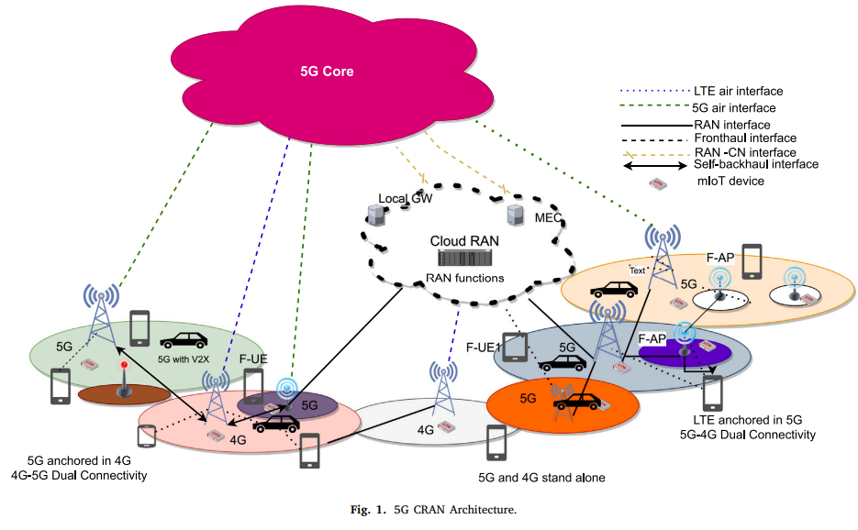
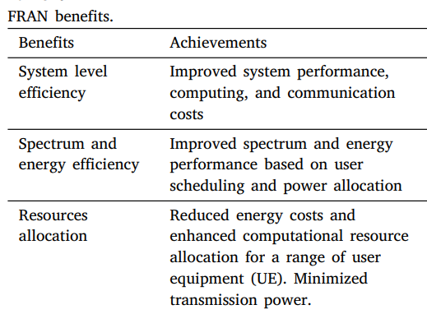
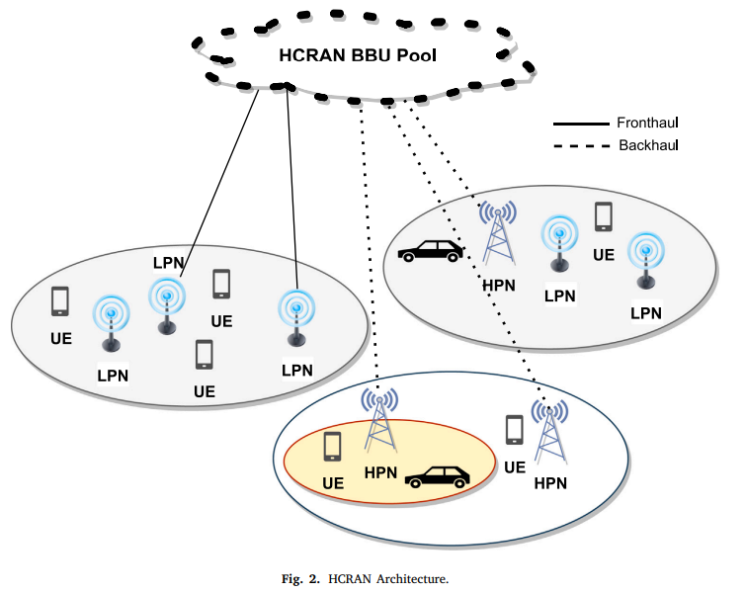
5G Radio Access Networks: A Survey
Link to the paper
TM
Methodology
The fifth generation (5G) technology is a major component of the Fourth Industrial Revolution (4IR), which supports the use of integrated spectrum with traditional technologies.5G aims at delivering enhanced mobile broadband (eMBB), massive machine-type communication (mMTC), and ultra-reliable and low-latency communication (uRLLC)..
Introduction
Results
Objectives
To provide enhanced user’s quality of experience (QoE) and satisfy vertical industrial requirements.
studying these RAN architectures from various perspectives such as energy and spectrum usage, CAPEX/OPEX, system level performance.
Conclusion
5G necessitates a complete rethinking of mobile network design, particularly the RAN architecture because of huge connectivity, massive data, and new expectations for extremely low latency and higher data rates. The goal was to explore the benefits of CRAN and HCRAN while not disregarding the challenges that each network design encounters. In the case of FRAN, a different method was followed, with the focus being on resource categories within the design layers and then an analysis of resource management system.
Requirements
1. CRAN splitting the BS into BBU and RRH.
2. Need for dense 5G RANs
3. Improving QoS for end users.

Slide 12
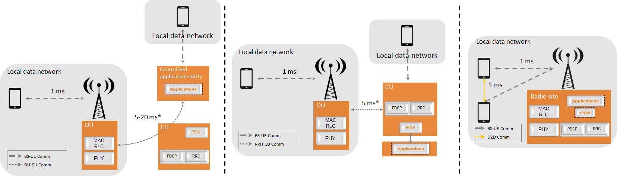
5G Ran For Verticals: Challenges And Enablers
Link to the Paper
TM
Methodology
5G networks involve the so-called enhanced Mobile Broadband (eMBB) service, along with this the 5G design has to meet the requirements of two “new” mobile services: massive Machine Type Communications (mMTC), characterized by a very large density of connected objects and Ultra-Reliable Low Latency Communications (URLLC), characterized by stringent requirements in terms of low latency and high reliability.
Introduction
Results
Slicing is expected to facilitate openness of the network to third parties, or tenants (e.g., a virtual network operator or a vertical). Openness of the network to third parties is regarded as a key issue as it may encourage some vertical players to use operators’ networks and thus it raises several issues against the third parties on the global performance of the network.
Slice monitoring has to report Key Performance Indictors (KPI) that are user-related (throughputs, delays, reliability), but also network-related (per slice load and energy efficiency). The latter KPIs are challenging to assess as they are related to the infrastructure that is shared between slices.
Objectives
Identifying the plausible options for implementing slicing concept at the RAN level to respond to needs of verticals.
Satisfying the RAN slicing for meeting the heterogeneous service requirements while sharing the same radio and processing resources.
(a) URLLC slice with very stringent latency
constraints (e.g. industrial control). Virtual
PGW (vPGW) and applications are in the
radio site.
(b) Wide area coverage slice with distant
applications (e.g., eMBB), while the Packet
Gateway (PGW) is in the CU.
Conclusion
This paper has investigated slicing concept in the 5G RAN, plausible options for slicing concept at the RAN level to respond to needs of verticals. While the lower layers need not know exact ID of slice, they should respond to their heterogeneous requirements. Different concepts, challenges related to RAN slicing and their management have been described. The tiling concept allows implementing different PHY/MAC configurations on the same spectrum, slice management entity maps slices to tiles at a relatively long time scale.
Requirements
Slicing Granularity at the RAN
Slice isolation and spectrum sharing
Tiling and Scheduling
Puncturing concept for URLLC scheduling
Slice identification and mapping
Architectural considerations
Slice – specific configurations
Resource Allocation
SLA Monitoring
(c) Slice with regional footprint and medium
sensitivity to latency (e.g., augmented reality).
Both applications and PGW are in the CU.

Slide 13
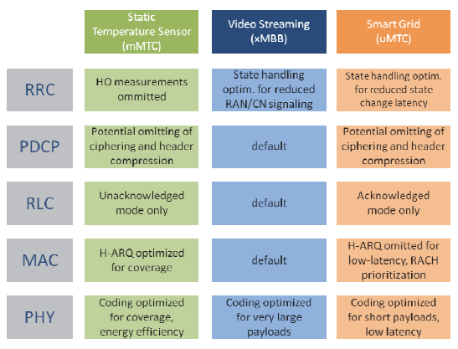
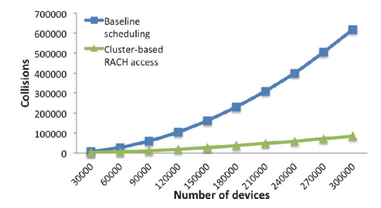

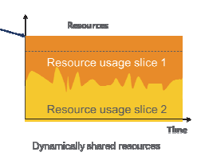
Impact of Network Slicing on 5G Radio Access Networks
Link to the paper
TM
Methodology
Network slicing is an important part of the NGMN’s vision for the overall 5th Generation (5G) architecture that addresses the deployment of multiple logical networks as independent business operations on a common physical infrastructure. The ultimate goal is to provide “network slices on an as-a-service basis” and also meet address the needs of different 5G use cases with highly diverging requirements.
Introduction
Results
Objectives
To contribute to the RAN design by analyzing the requirements needed to support network slicing.
To identifies parts of the RAN that will most likely to be affected by this network slicing requirements.
Fig. Example of how service-tailored random access optimization can be beneficial in mMTC using cluster based access
Conclusion
Requirements
Fig. Example of service-tailored optimization for different slices.
The paper presented a set of requirements to guide the 5G RAN design in order to support the concept of network slicing. These requirements should drive the design of a common protocol architecture supporting multiple slices and services, but allowing slice-tailored optimizations and NFs usage. The most efficient way to realize and/or standardize this common architecture is still under investigation.
Maximum utilization of RAN resources
RAN should be made slice-aware
Support mechanisms for traffic differentiation
RAN should support protection mechanisms
RAN should support infrastructure management
Protocol architecture
Design of Network Functions(NFs)
Network management
Impacts
Fig. One way to make RAN slice-aware is via a Slice-ID.

Slide 14
Functional and Non-Functional Requirements
Functional requirements
The network shall offer tailored solutions for each slice.
The network slices shall be completely isolated from each other.
The network shall get sliced dynamically according to requirements.
Non-Functional requirements
The network should have latency less than 10ms.
The network should allow a maximum of eight slices.
The network should be able to offer data speed more than 1000mbps

Slide 15
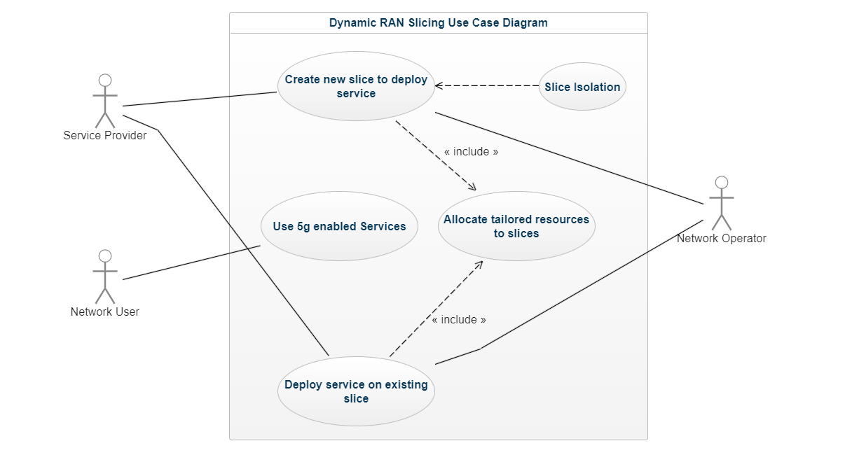
Use Case Diagrams
<< extend>>
Fig. 2. Use Case Diagram of the Proposed System

Slide 16
Use Case Description
Use case: Dynamic ran slicing
Primary Actor: Network Service provider, Network user, Network operator
Goal in content: To create, operate and deploy 5g enabled services on custom network slices on common physical network
Preconditions: Proper Isolation of slices
Trigger: Creating multiple networks on top of common physical infrastructure.
Scenario: 1. Create a new slice.
2. Deploy service on existing slices.
3. Allocation of tailored resources to slices.
Exceptions: Different use cases have different requirements

Slide 17
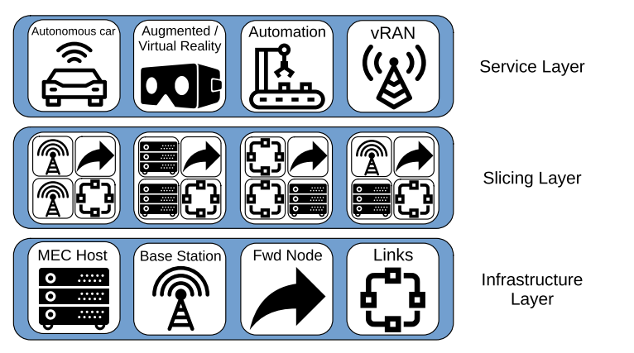
Architecture of the System
The eXP-RAN emulator architecture is divided into three layers
The Infrastructure layer
The Slicing layer
The Service layer
The Infrastructure layer
Virtual resources creation and emulation of physical resources are done by this layer.
The Slicing layer
Virtual resources are partitioned and isolated by this layer by slicing the allocated resources, thus emulating the slices created upon the common infrastructure layer.
The Service layer
The services created inside the network are emulated by this layer which is present as a set of network functions.

Slide 18
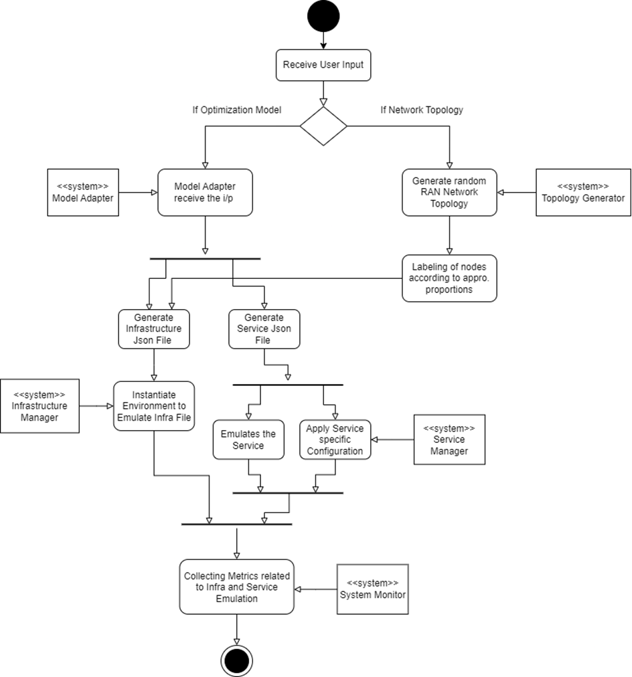
Activity Diagram

Slide 19
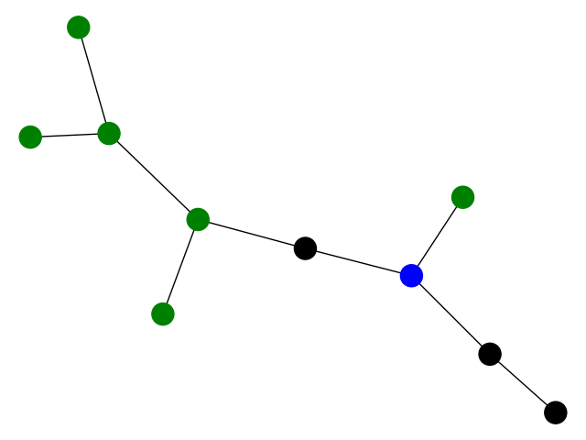
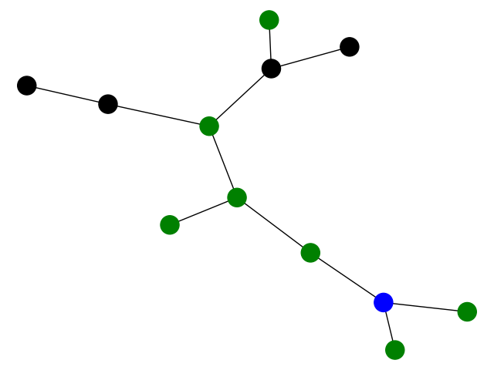
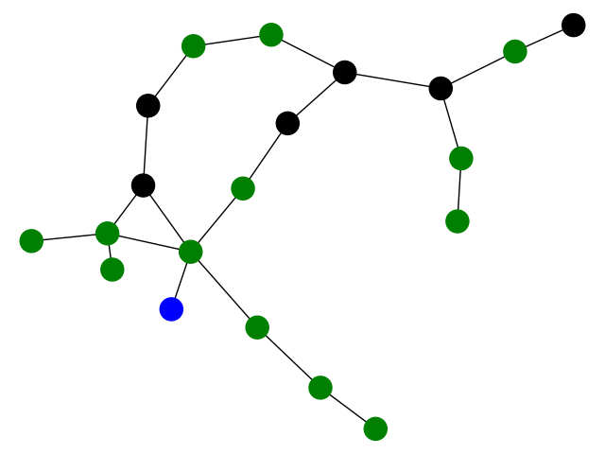
Implementation And Results
MEC Host
Fig. 4. Randomly generated Topologies
Forwarding Nodes
Base Station Nodes
These are some of the randomly generated network topologies with
5% of the nodes are MEC Host
30% of the nodes are Base Stations
65% of the nodes are Forwarding Nodes

Slide 20
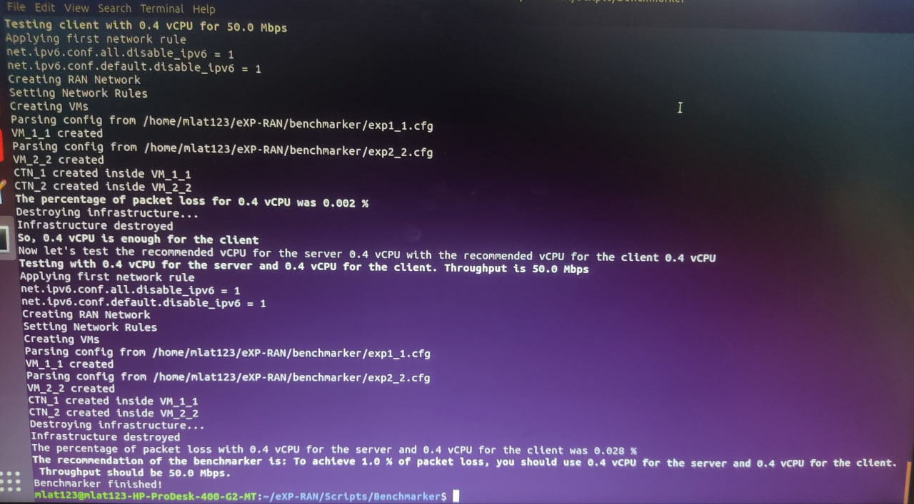
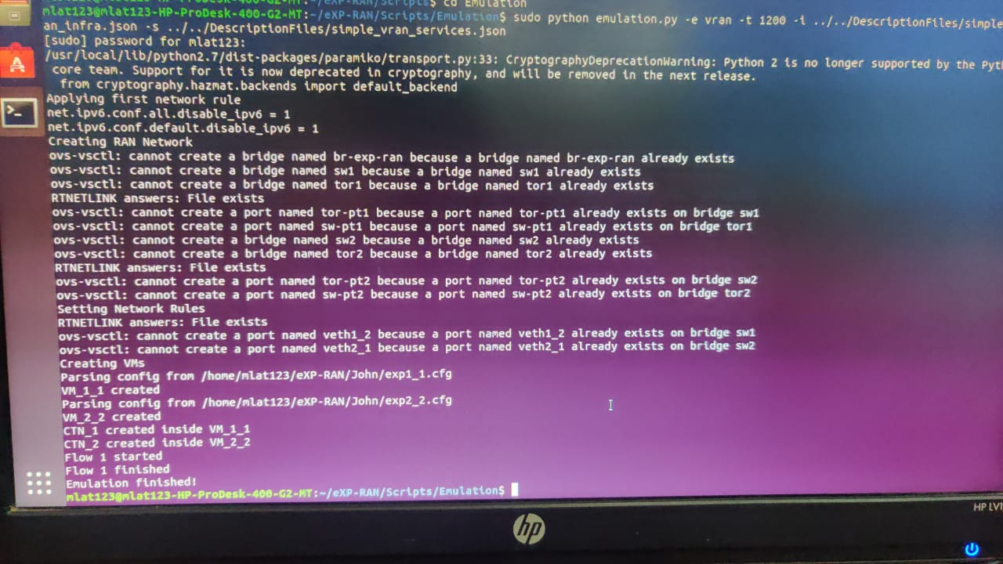
Implementation And Results
Fig. 5. Snapshot Benchmarker Module Emulation
Fig. 6. Snapshot of Video Streaming Service Emulation

Slide 21
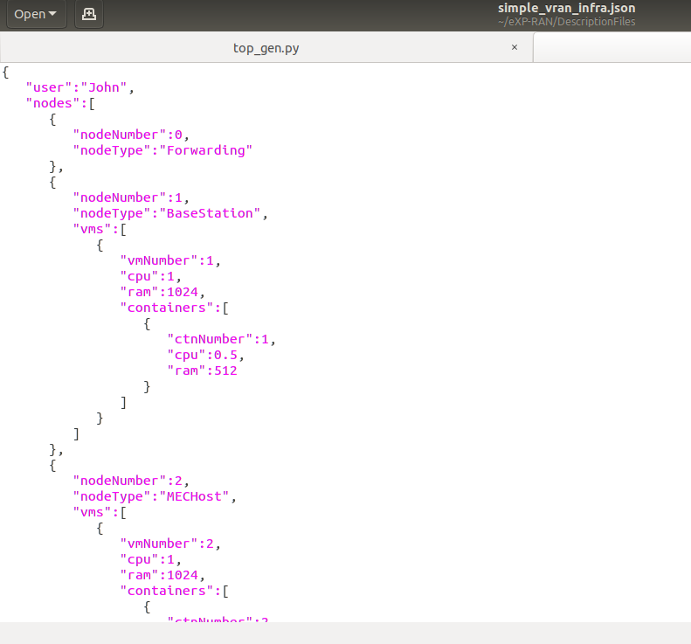
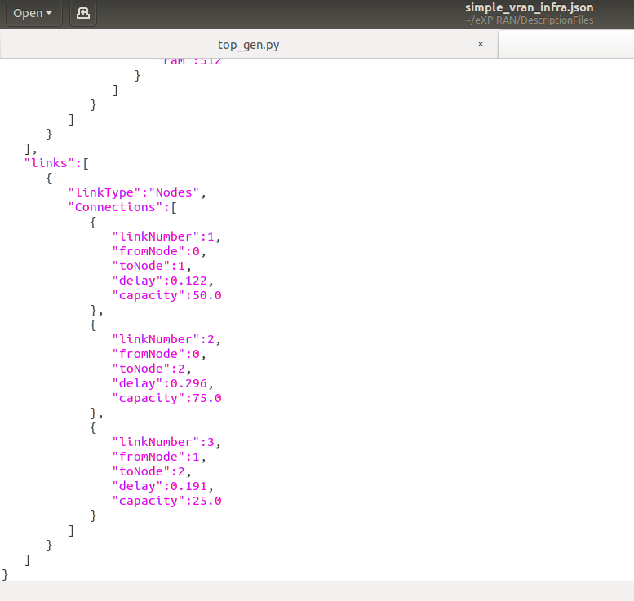
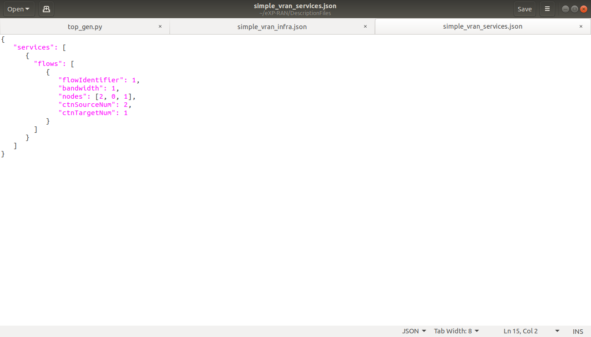
Implementation And Results
Fig. 7. Snapshot of Infrastructure and Service Description Files

Slide 22
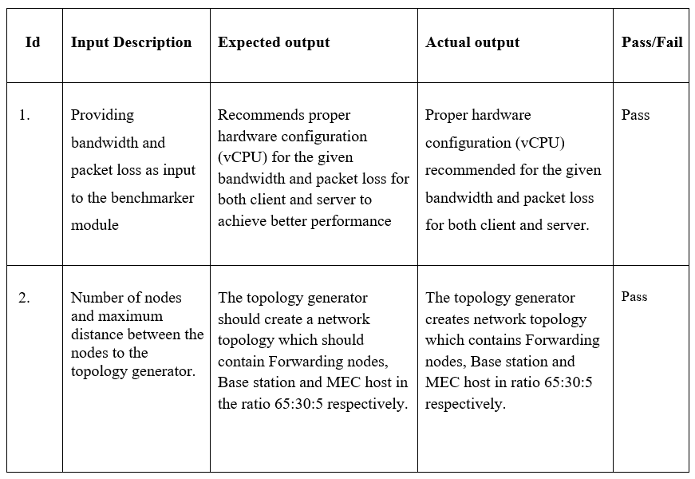
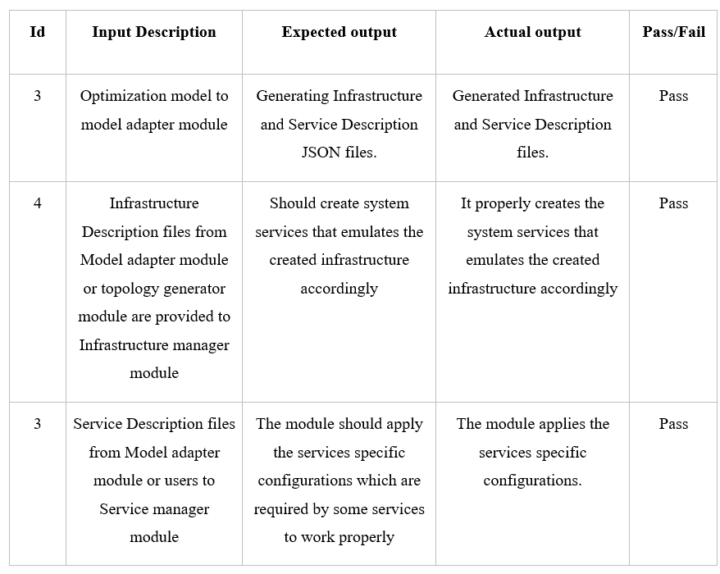
Acceptance and Unit Testing
Fig. 8. Acceptance Testing
Fig. 9. Unit Testing

Slide 23
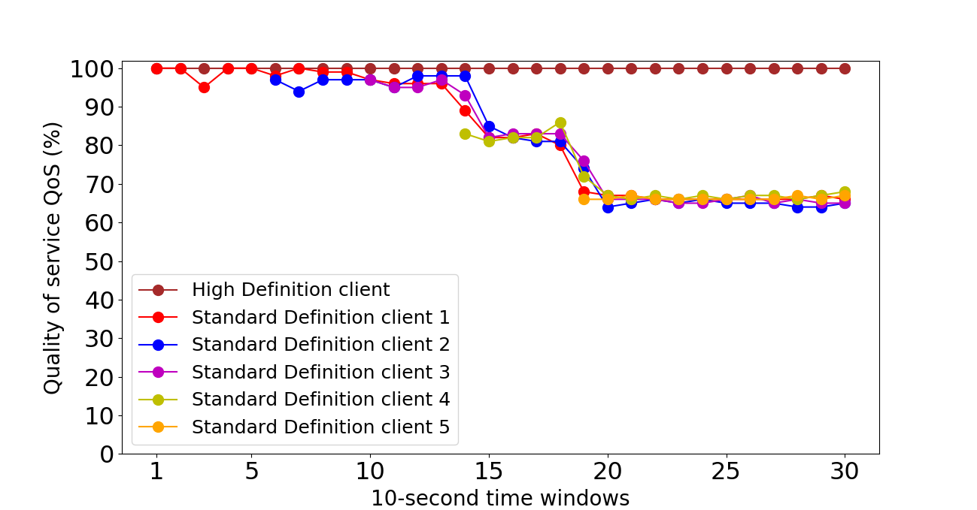
Expected Results / Measurable Outputs
We considered two slices. One denoted by ‘High Definition’ slice, provided to video service provider A, while the other denoted by ‘Standard Definition’ slice, provided to video service provider B.
Fig. 10. represents the result of the experiment. The x-axis indicates the number of the time window, where each time window has a length of 10 seconds. Each point in the y-axis represents the quality of the service received by each client during the 10-second time window.
The QoS is the ratio between the average expected throughput and the average provided throughput to the video flow.
Fig. 10. Plotting of Experimental Results

Slide 24
Conclusion
We thus conclude that the QoS of the slices that are provided to the users gets affected due to the workload present on the slices.
In this experiment, when workload starts to increase, QoS being given to users belonging to ''High Definition'' remains unchanged, whereas for the user belonging to 'Standard Definition', the QoS starts to decrease, as the workload increases.
Therefore, the created slices are behaving as expected and able to meet their expected requirements.

Slide 25

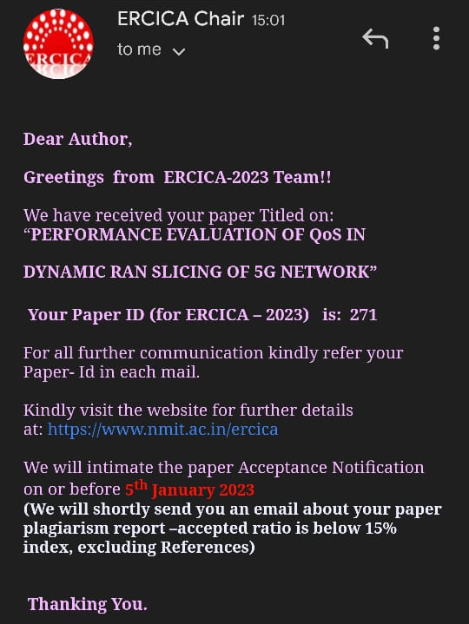
Current Status of Paper

Slide 26
THANK YOU

